Slide 1




Slide 2
Our team:
Tataru Dan | Andranovici Dumitru | Nani Victor | Brinza Cristian | Otgon Dorin

Slide 3
The Problem:

Slide 4
Nowadays, people have become less sociable, or for some reason find it difficult to find new friends or interest groups to join.

Slide 5
A solution to this problem would be to find a way to locate people with increased chances, who are more likely to meet the requirements.

Slide 6
An application for this purpose, creates many possibilities, facilitates socialization and finding possible future acquaintances.

Slide 7






BONFIRE
TEAM 14 | HACKATHON 2022
powered by: sponsored by:

Slide 8



What is Bonfire ?
Bonfire is a free web application which find a way to locate people with increased chances, who are more likely to meet the requirements.
TEAM 14 | HACKATHON 2022

Slide 9
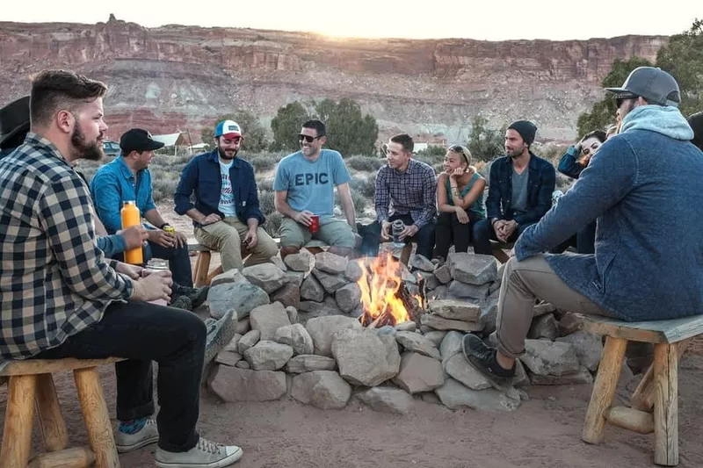

Slide 10
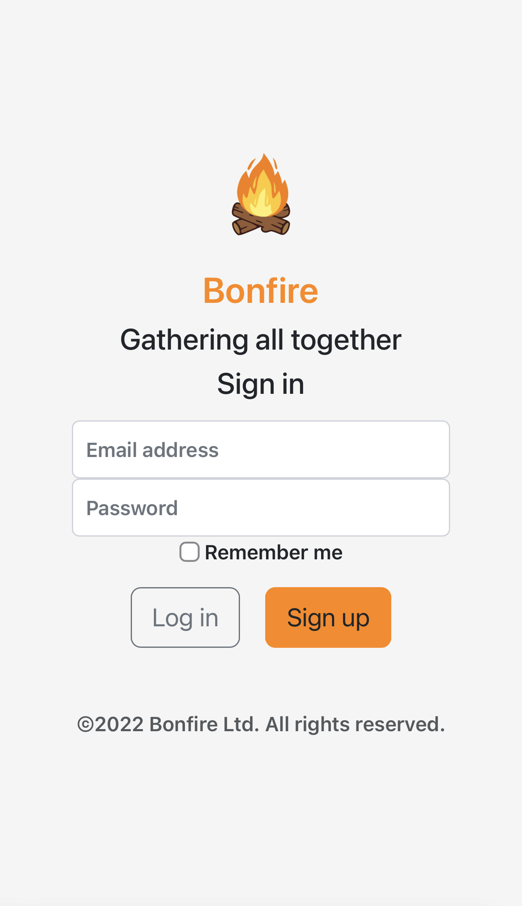
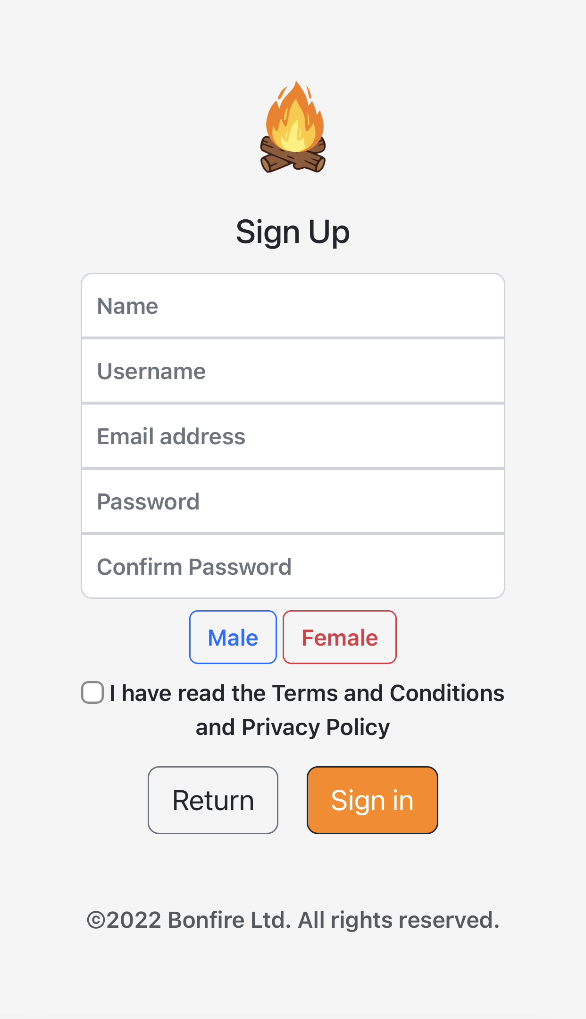

Slide 11
Features

Slide 12
Basic Features

Slide 13

Minimalistic approach Accent color
Adventure
Fun
Friendliness
Colors:
-#12130F - smoky black
-#F1F2F6 - cultured
-#FF8600 - Dark Orange
It is a beneficial color for apps that target interaction and can stimulate social communication. Orange is friendlier, approachable and less aggressive than red. And does make the impression of promoting point of sale purchases as yellow.

Slide 14
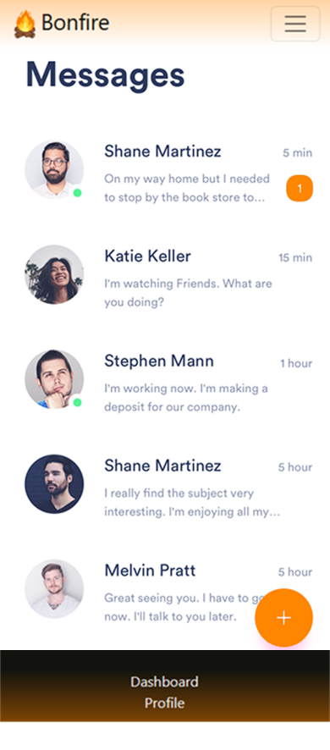
Private Messaging system

Slide 15
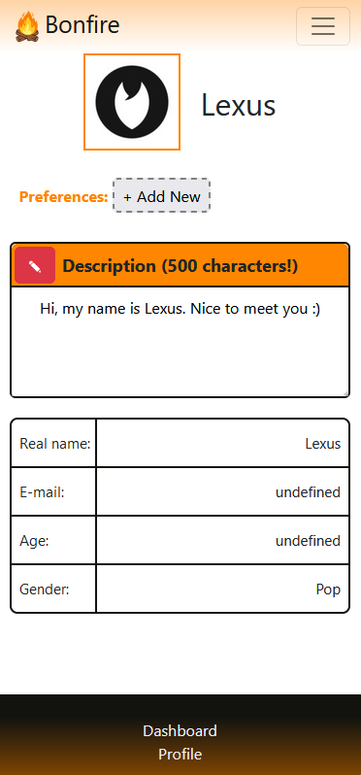
- Profile Customization

Slide 16
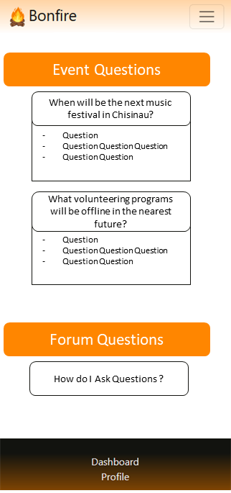
- A forum

Slide 17
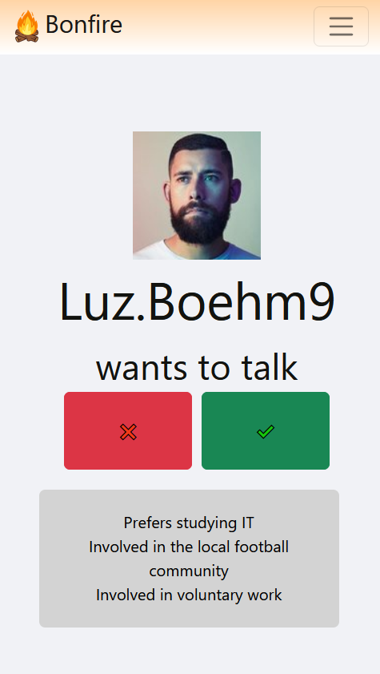
- Swipes

Slide 18
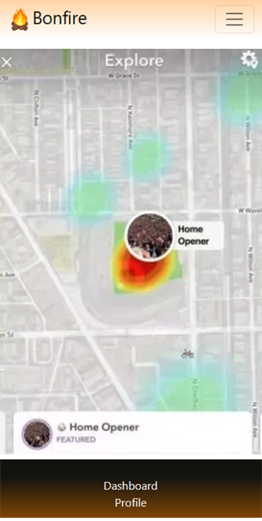
- Area Location sharing and search

Slide 19
Additional Functional Features

Slide 20
Not showing activity status
Searching specific profile
Costume event creating
A “MY PLANS” to do list

Slide 21
Killer Features

Slide 22
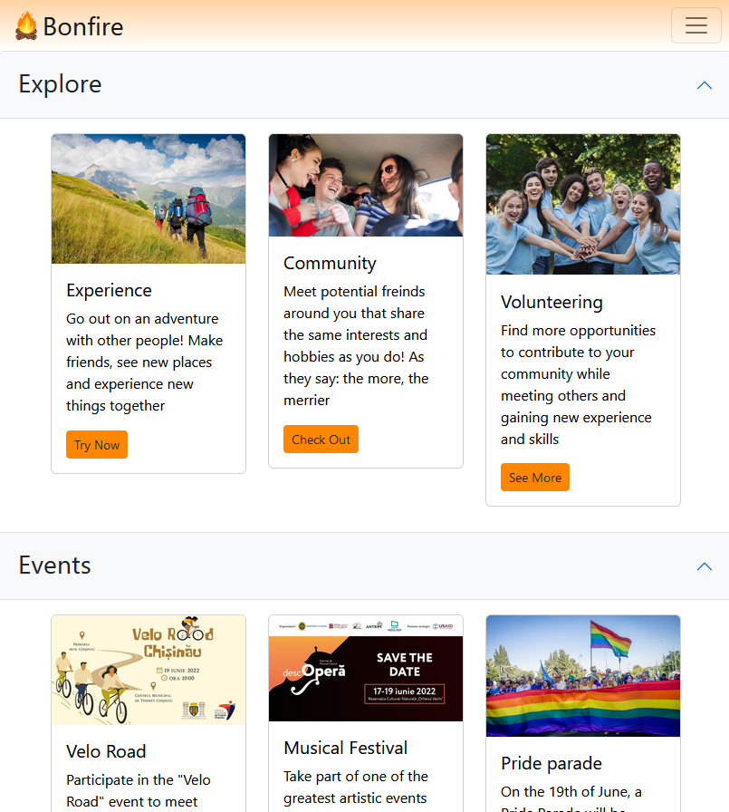
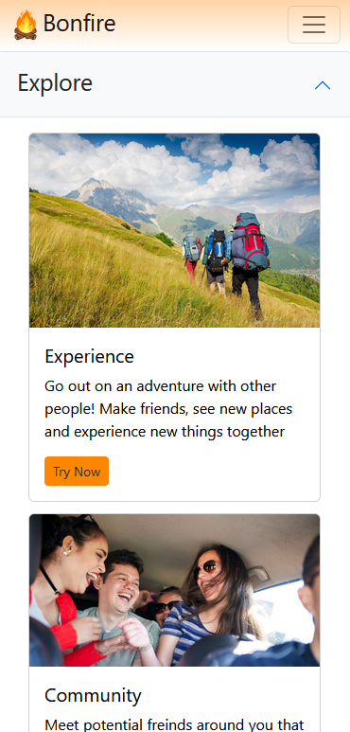
- Tabs

Slide 23
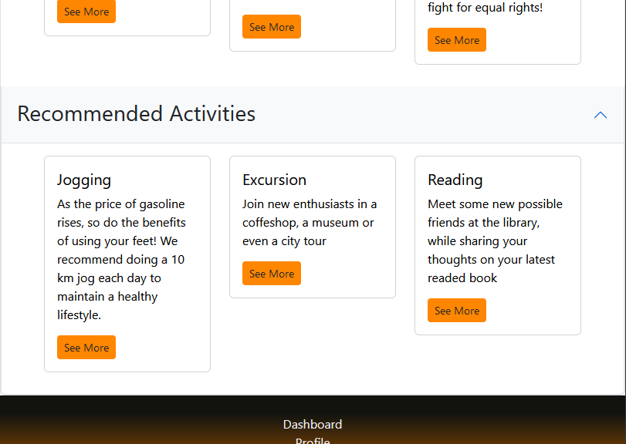
- Suggestions

Slide 24
Additional Killer Features

Slide 25
A “Event possible plans” roadmap
Group Chat
Ticket links/reservation

Slide 26
Features we want to add

Slide 27
Profile statistics
Best Matches Suggestions

Slide 28
Thank you for attention

Slide 29
